Slide 1


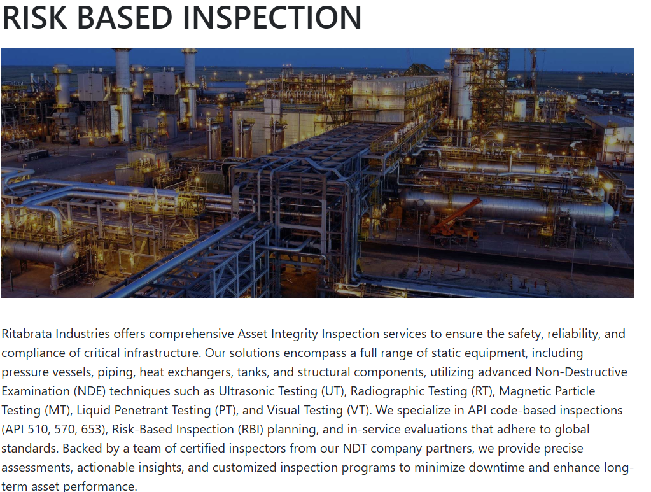

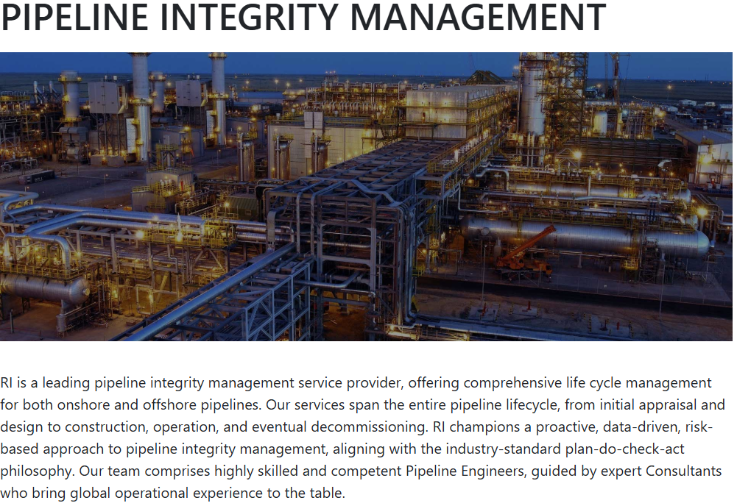
Introducing
Risk Based Inspection
By
Ritabrata Industries

Slide 2
Intuitive Workflows in Risk Based Inspection
Asset Management
Asset catalog
Import Assets
Risk Management
Part risk ranking
Part risk matrix
Risk history
Inspection Management
Inspection planning
Report workflow
User Management
User and role management
Role based access control
Systems Management
Master and configuration data management
Batch Management

Slide 3
Asset Management

Slide 4
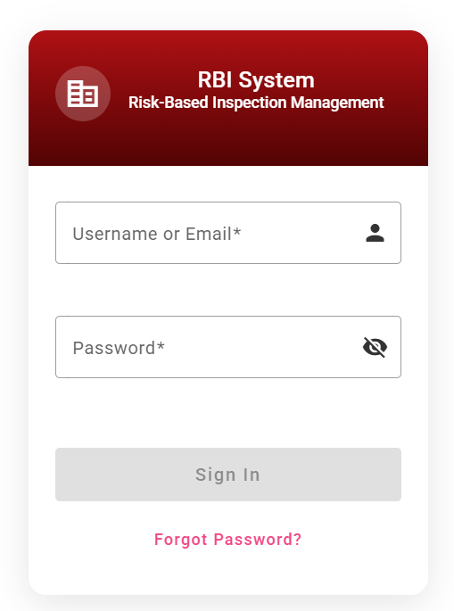
Login & Personas

Slide 5
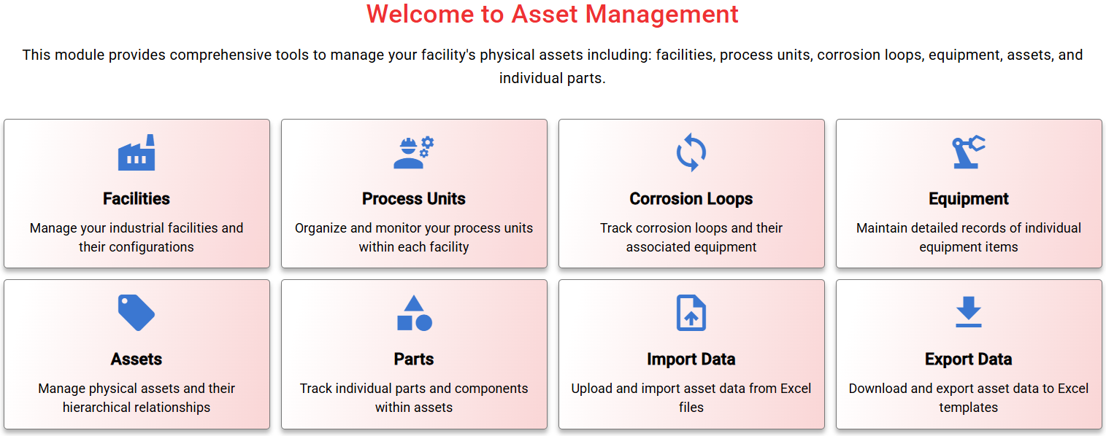
Asset Management Workflows

Slide 6
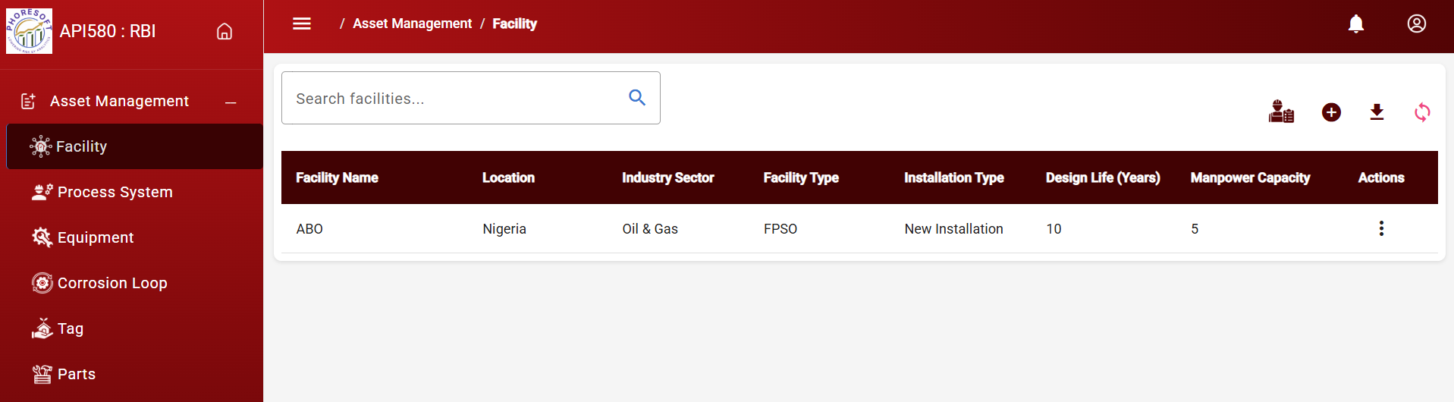
Facility Management

Slide 7
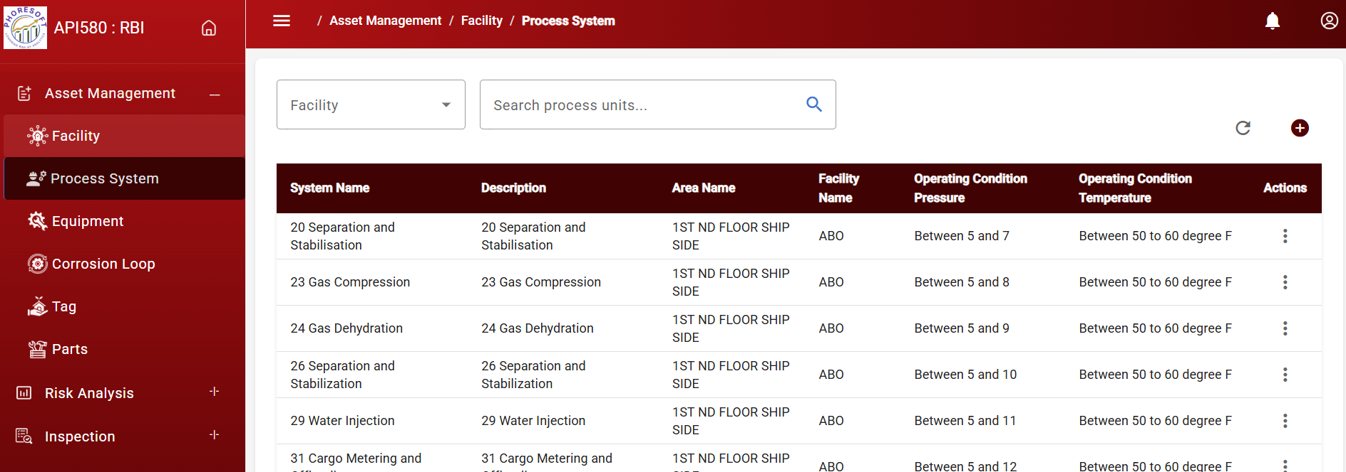
Process System Management

Slide 8
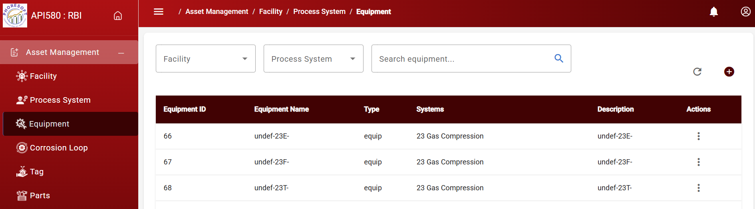
Equipment Management

Slide 9
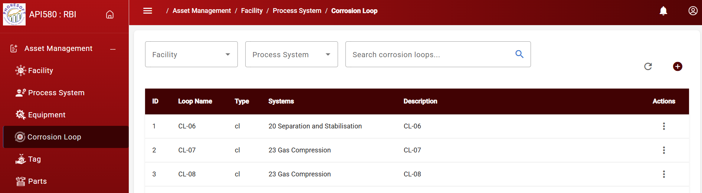
Corrosion Loop Management

Slide 10
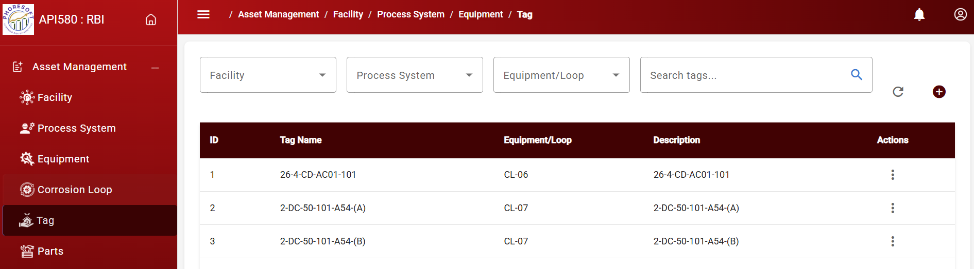
Tag Management

Slide 11
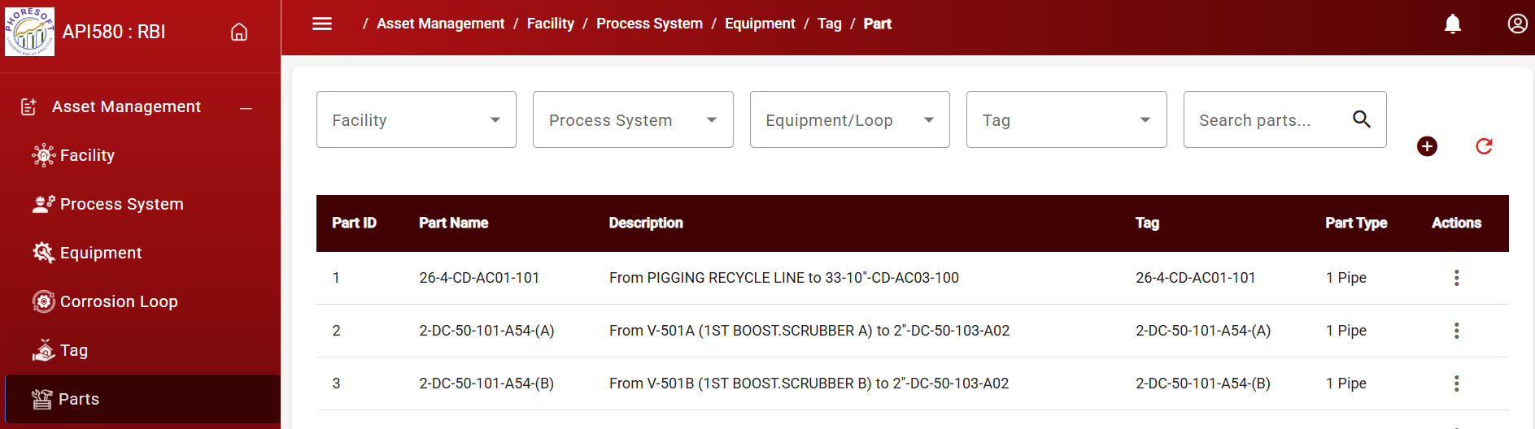
Parts Management

Slide 12
Risk Management

Slide 13
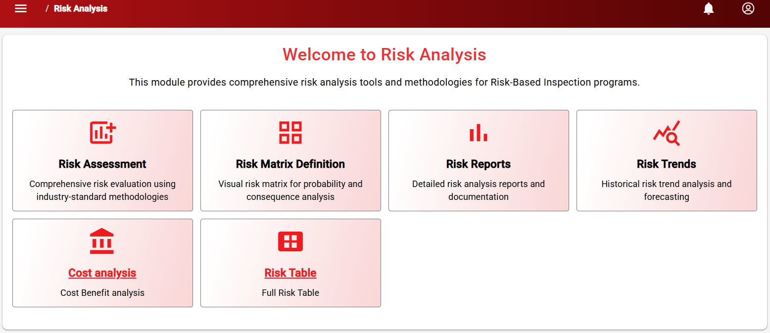
Risk Analysis

Slide 14
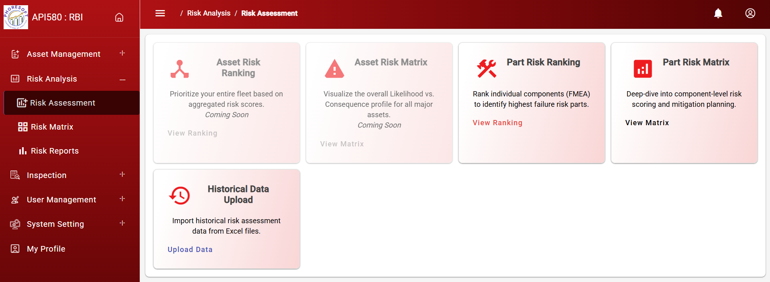
Risk Assessment

Slide 15
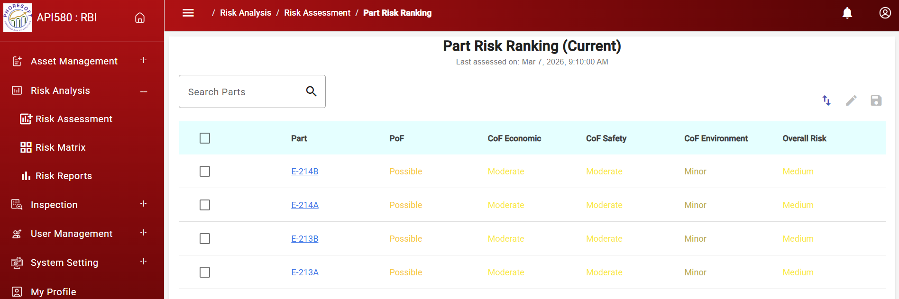
Risk Ranking

Slide 16
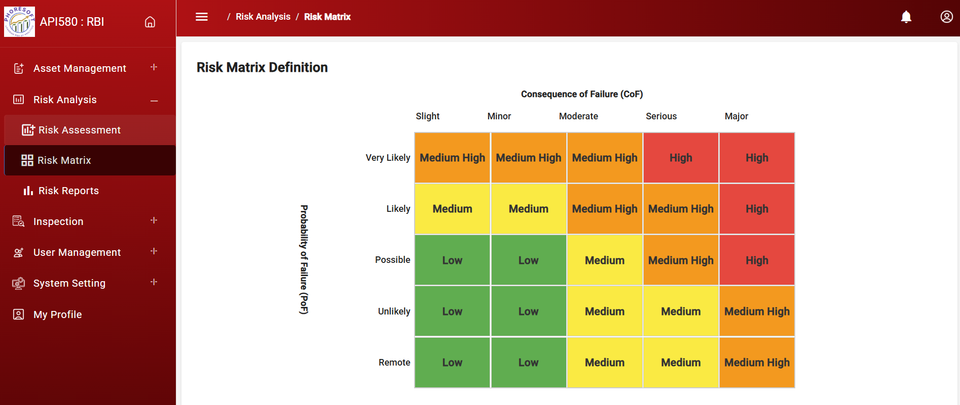
Risk Matrix

Slide 17
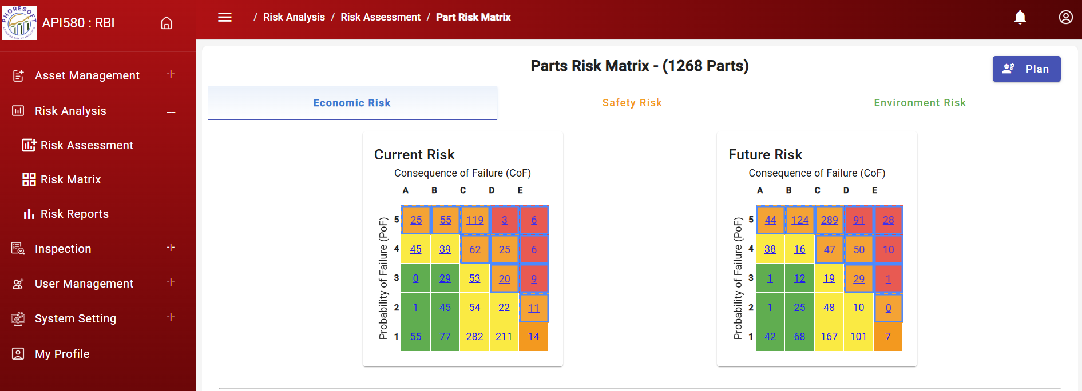
Risk Matrix - Economic

Slide 18
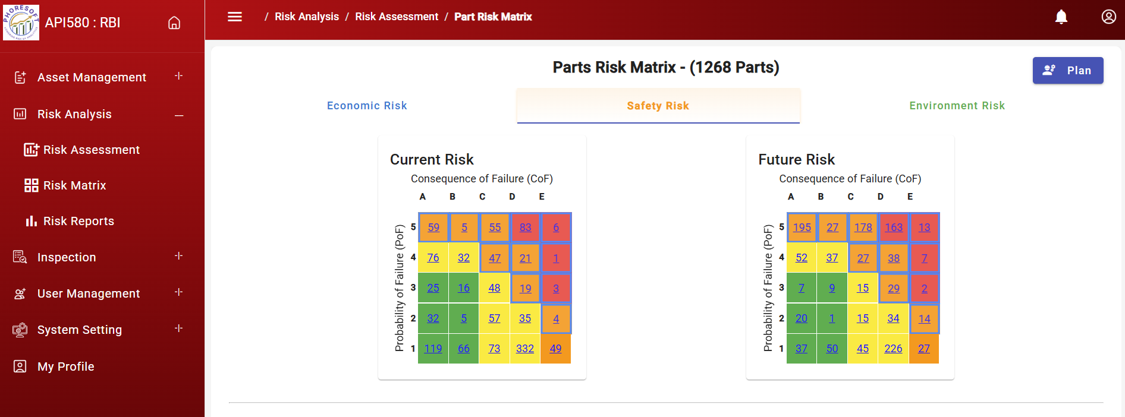
Risk Matrix - Safety

Slide 19
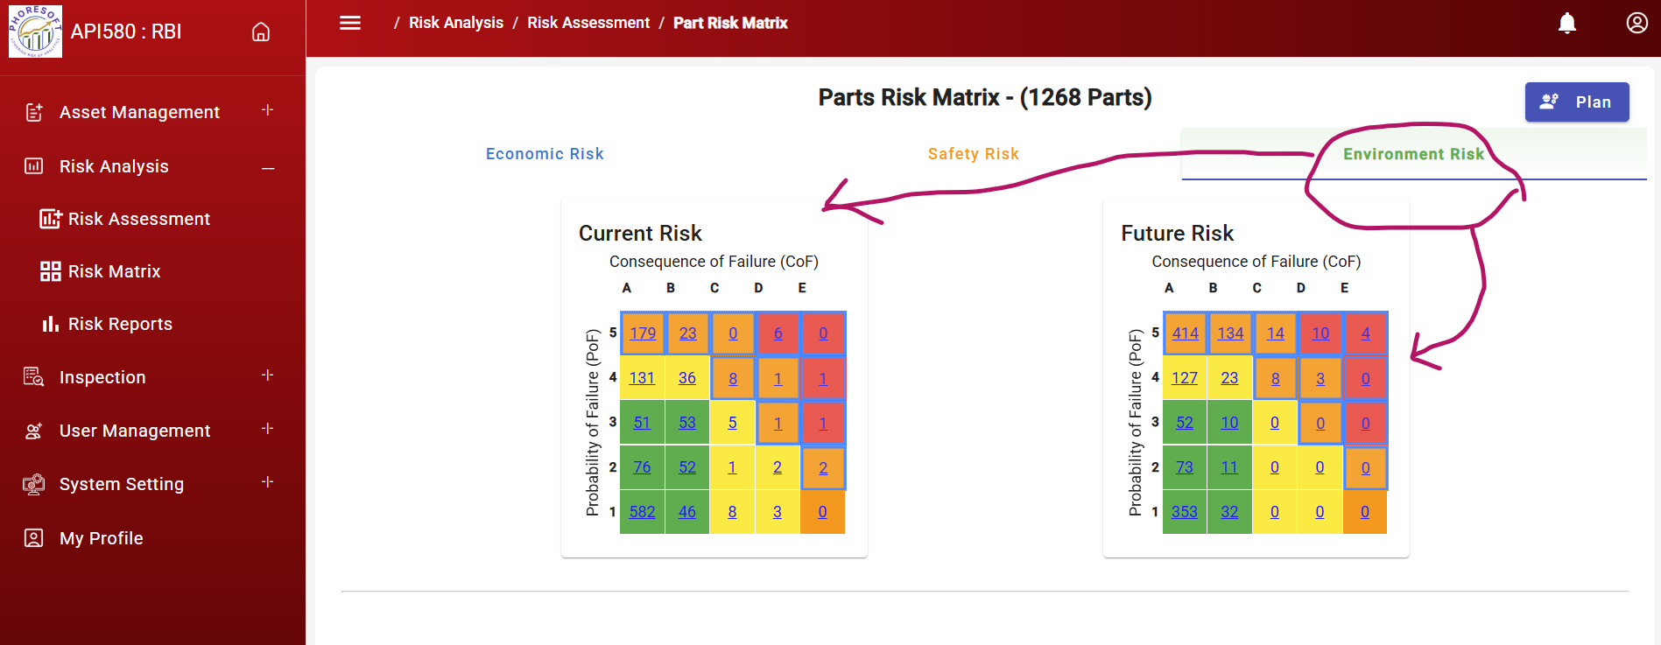
Risk Matrix - Environment

Slide 20
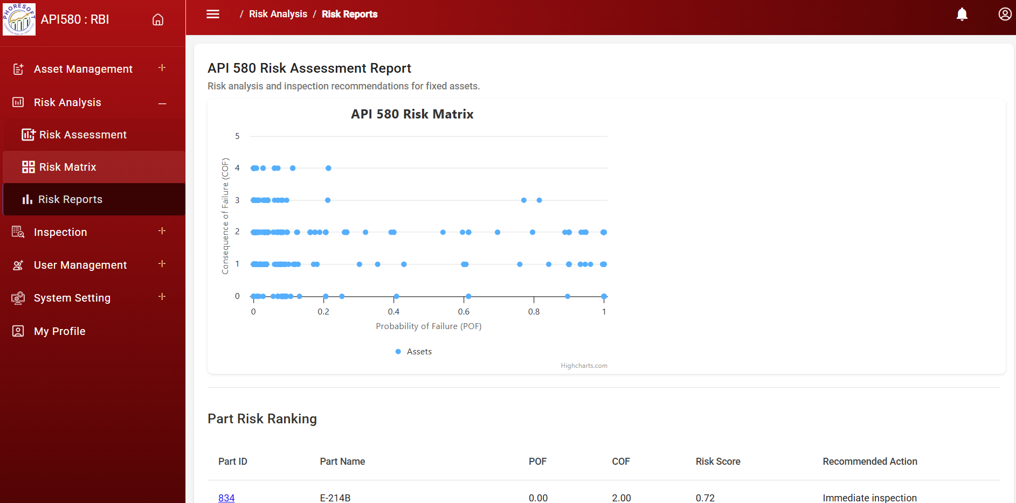
Risk Reports

Slide 21
Inspection Management

Slide 22
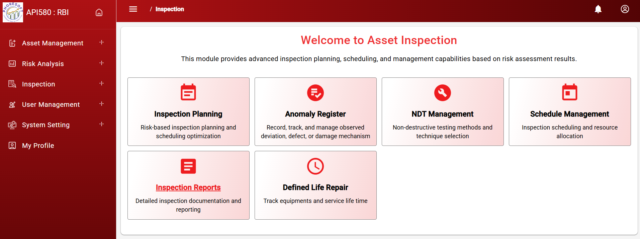
Asset Inspection Modules

Slide 23
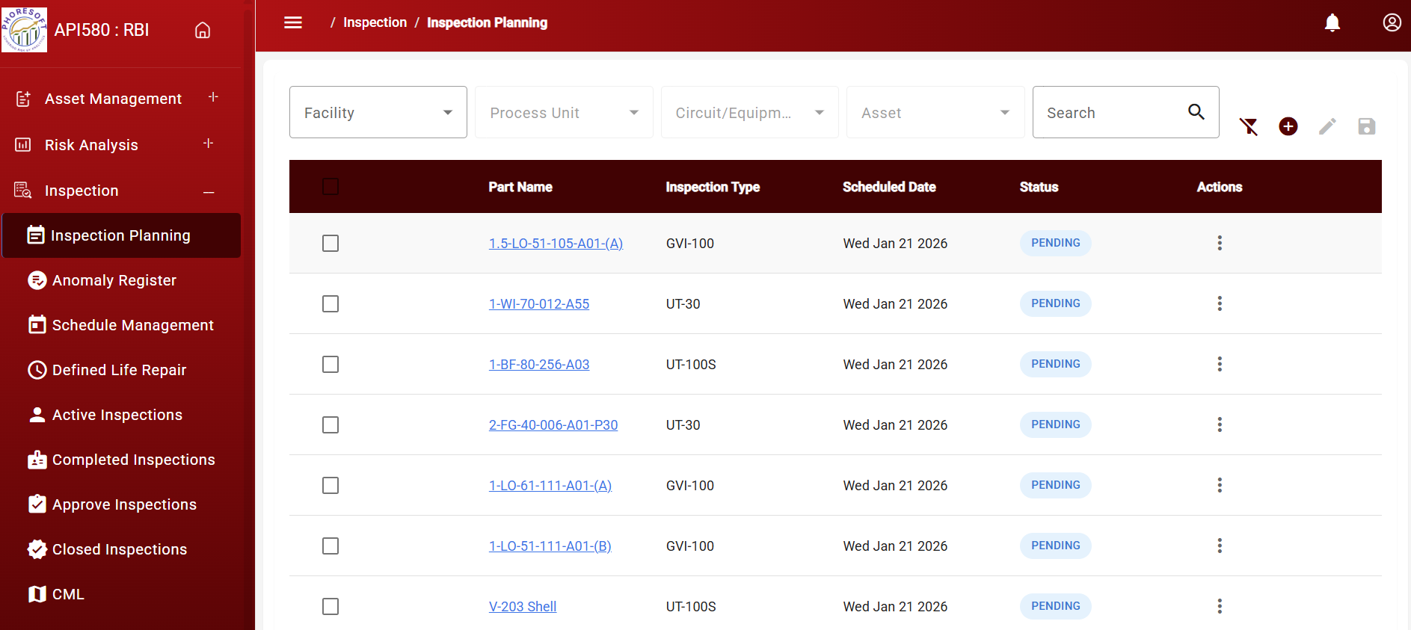
Inspection Planning

Slide 24
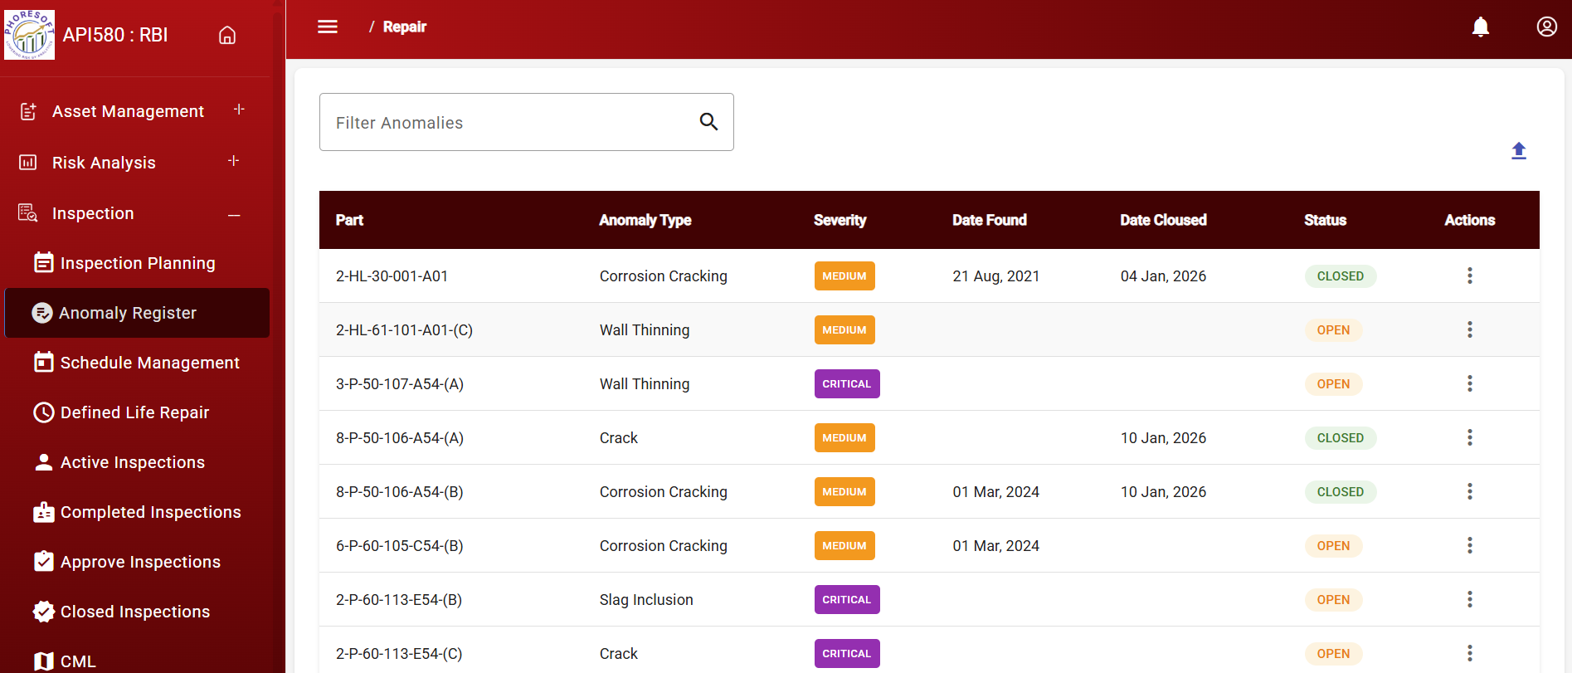
Repair

Slide 25
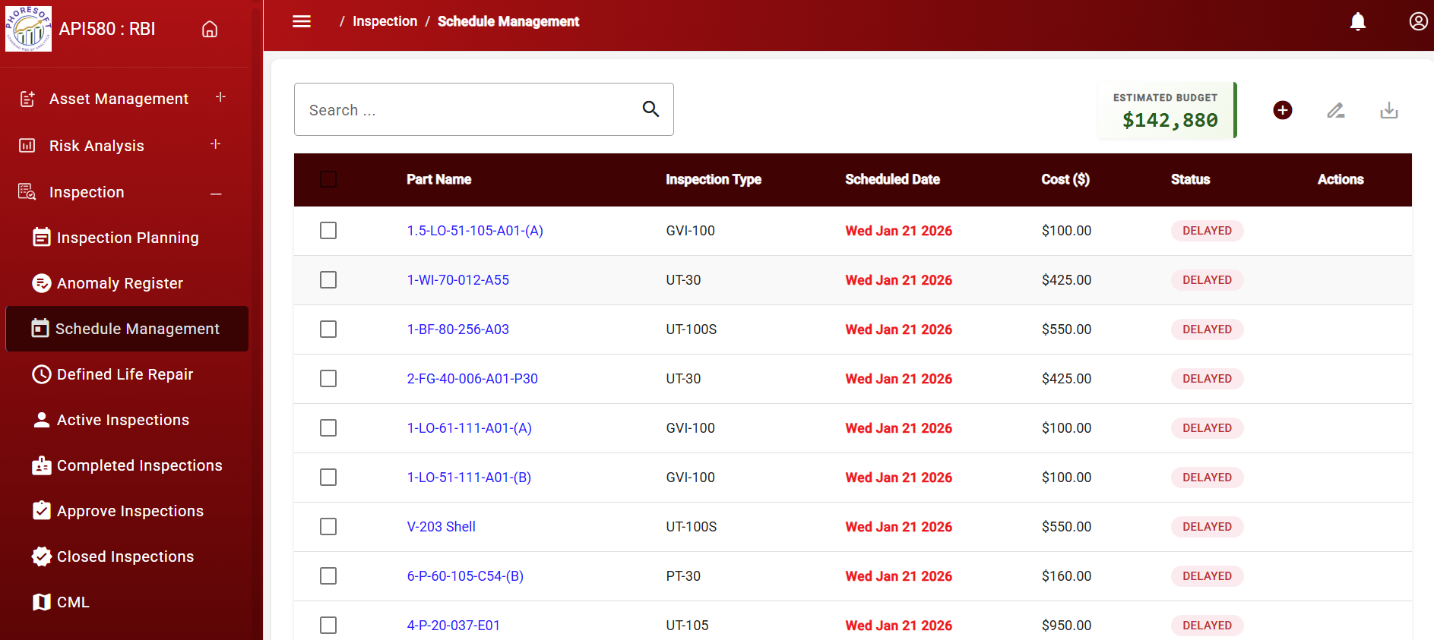
Schedule Management

Slide 26
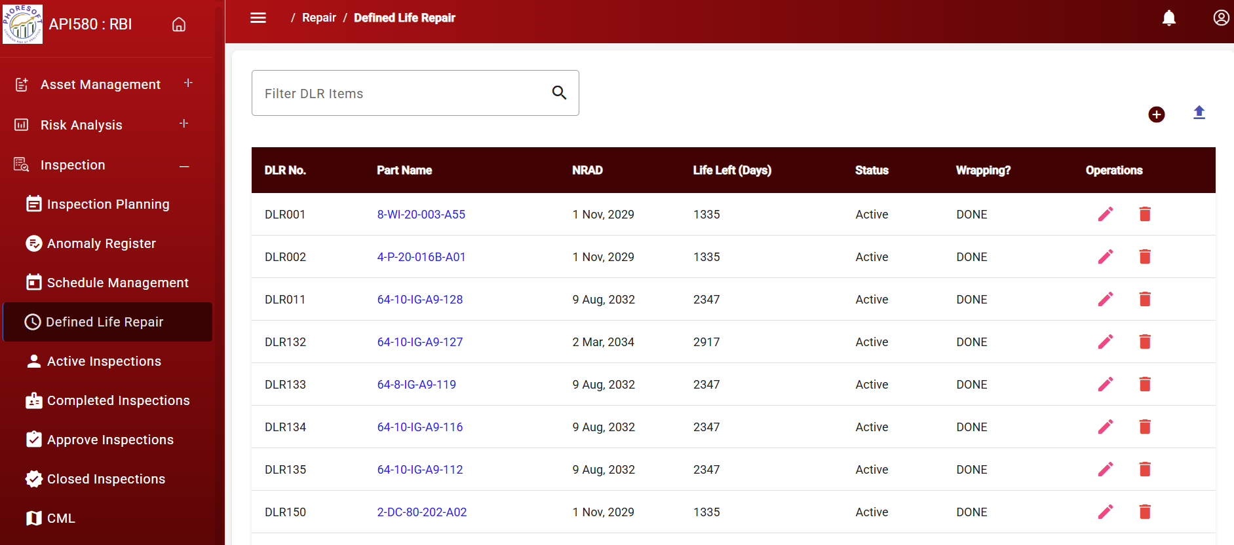
Defined Life Repair

Slide 27

Defined Life Repair Update

Slide 28
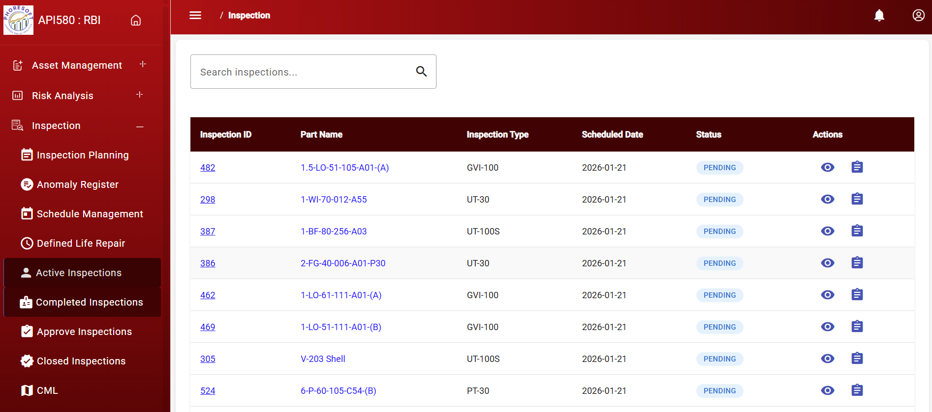
Ongoing Active Inspection

Slide 29
Completed Inspection

Slide 30
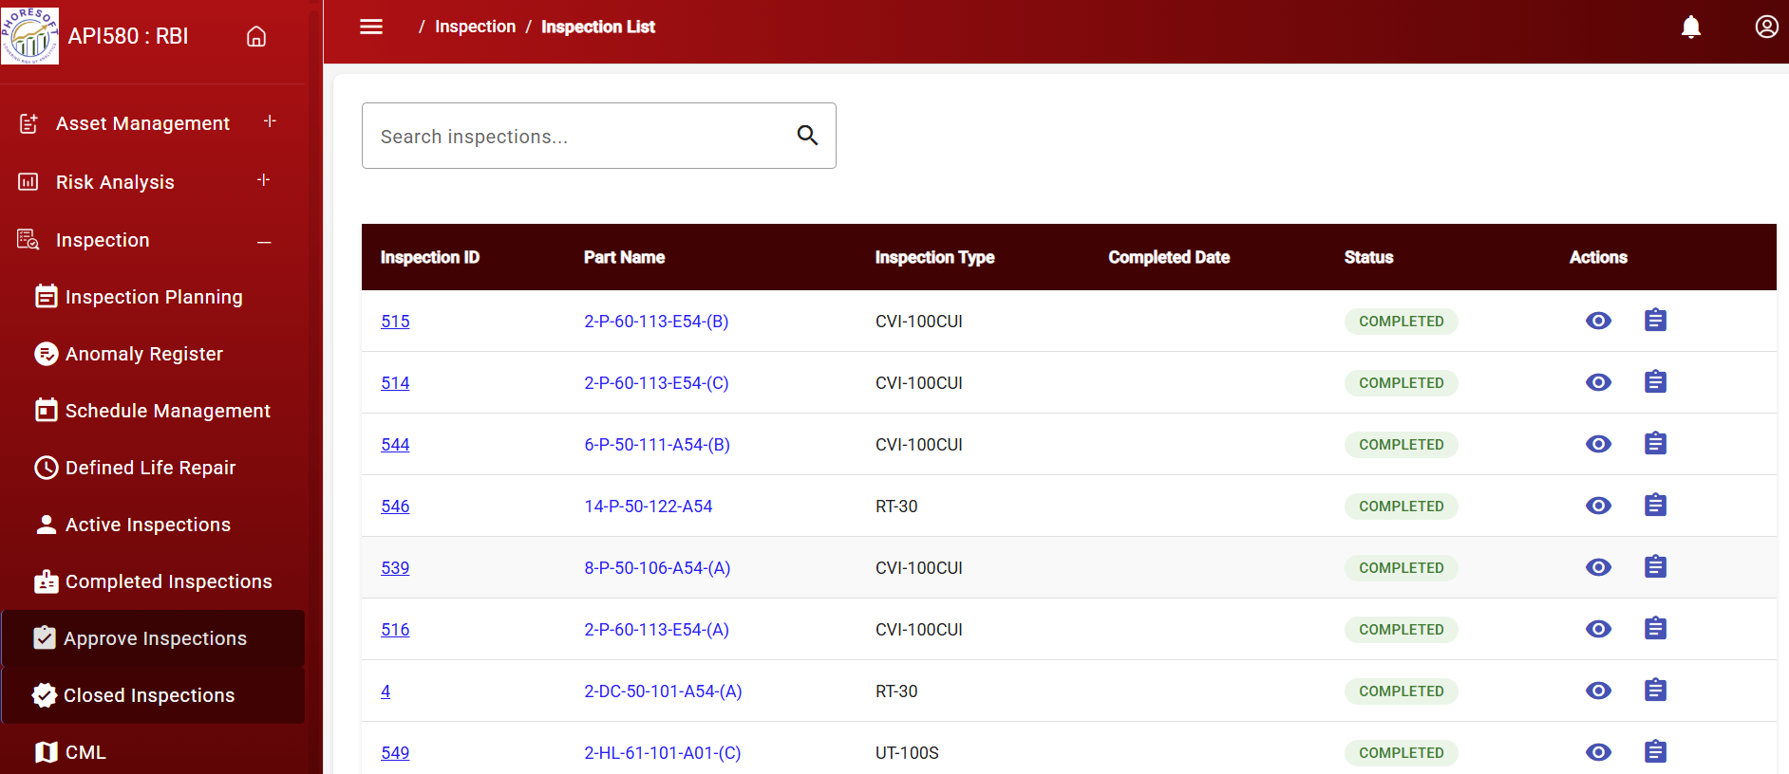
Approved Inspection

Slide 31
Closed Inspection

Slide 32
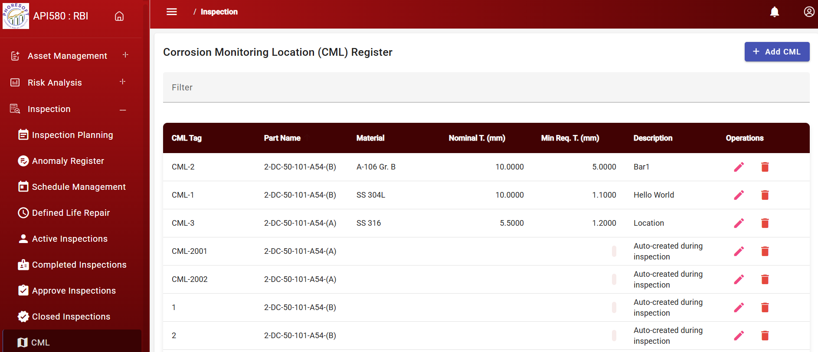
Corrosion Monitoring Location (CML) Register

Slide 33
User Management

Slide 34
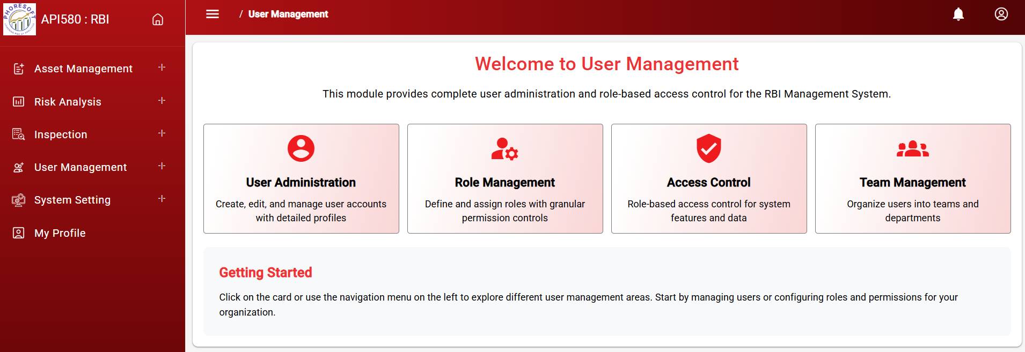
User Management

Slide 35
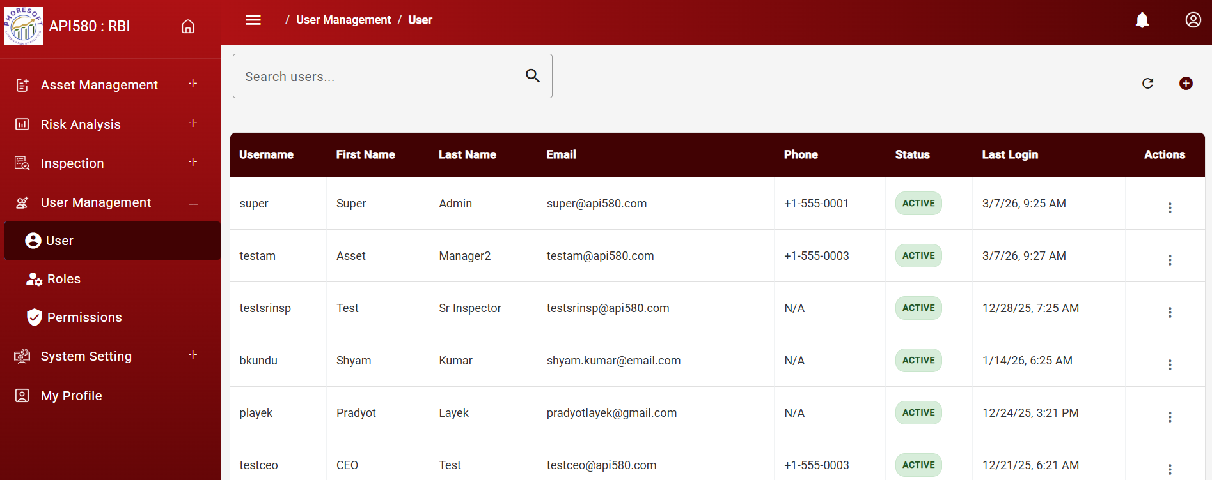
User Administration

Slide 36
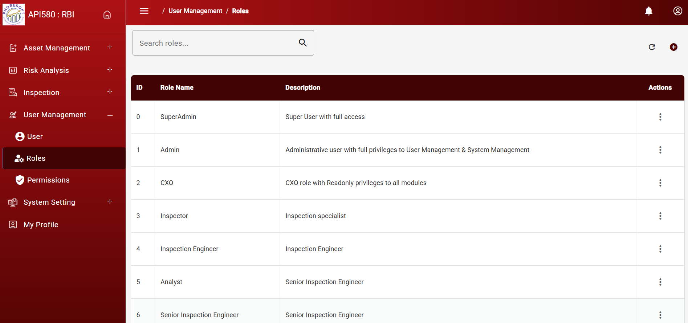
Role Management

Slide 37
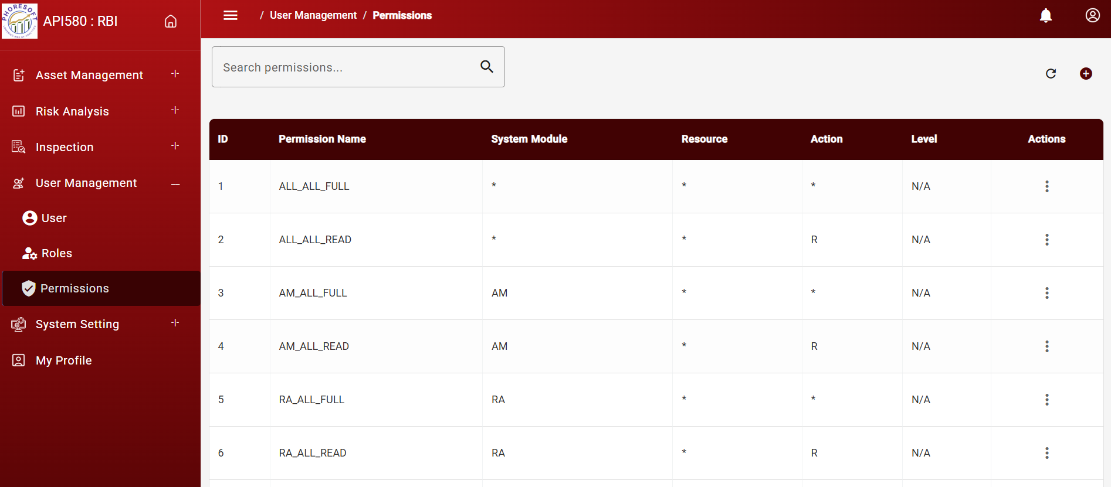
Access Control & Permission Management

Slide 38

Thank
You

